Slide 1
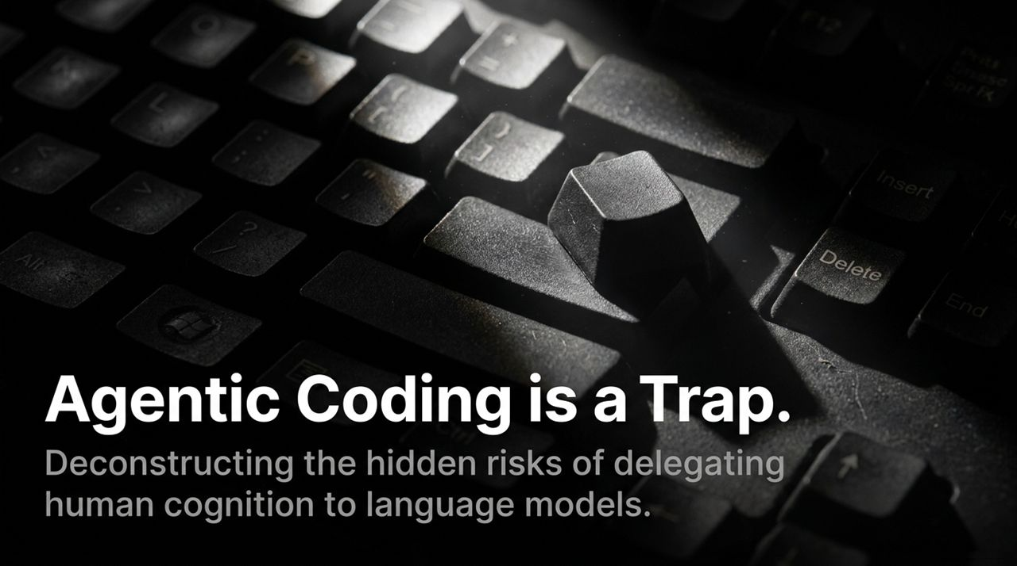
Notes:
Welcome, everyone. Today, we are deconstructing one of the most pervasive narratives sweeping software engineering, venture capital, and corporate tech leadership: the promise of Agentic Coding.
We are repeatedly told by tool vendors, influencers, and AI cheerleaders that writing syntax is dead. The message is simple: “You don't need to read code anymore; just prompt the AI agent and let it build the app.”
However, when you inspect what is actually happening on the ground in real production environments, a massive gap emerges between AI marketing hype and software engineering reality.
This presentation is grounded in the real-world experience and writings of Lars Faye—a 20-year agency developer and founder. Lars has watched tech crazes come and go, from the early web to low-code/no-code platforms, and now to LLM-driven agentic workflows.
Over the next 13 slides, we will examine:
The Disconnect: Why claims of developer obsolescence collapse under scrutiny.
The Expertise Paradox: Why AI tools require deep human expertise to evaluate, while actively preventing beginners from acquiring that expertise.
The Biology of Skill Acquisition: Why friction and failure are essential for building true mental models.
The Three Tiers of AI Delegation: Assessing risk across simple CMS builds, automations, and custom logic.
Syntax vs. Composition: Why LLMs excel at micro-level pattern matching but fail at macro-level architecture.
The Agentic Failure Loop: How un-audited AI code leads directly to vendor lock-in and unmaintainable tech debt.
The Historical Workload Paradox: How productivity revolutions increase demand for complex human output rather than eliminating jobs.
The Master vs. Mimic Framework: Practical strategies for preserving cognitive agency while using AI as a typing assistant.
Let’s begin by examining the disconnect between narrative and reality on Slide 2.
Only Good Devs Catch AI's Mistakes, and AI Makes You Worse - Lars Faye | Ep. 97
https://www.youtube.com/watch?v=0Kas27lxen4

Slide 2
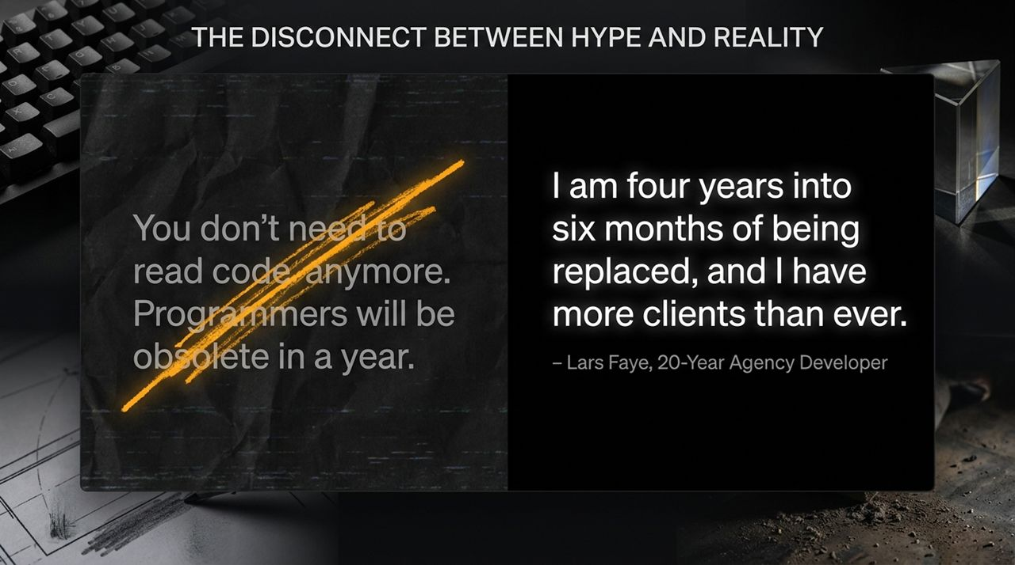
Notes:
If you spend five minutes on tech Twitter, LinkedIn, or YouTube, you will encounter headlines proclaiming: "Programmers will be obsolete in a year," or "The hot new programming language is English."
Yet, on the ground, veteran developers are experiencing something completely different.
The Reality on the Ground:
Consider the quote on the slide from Lars Faye: "I am four years into six months of being replaced, and I have more clients than ever."
For years, tech prognosticators promised that agency developers and custom software engineers would be rendered obsolete by automated tools. Instead, demand for skilled human developers who can reason through complex architecture, debug edge cases, and maintain legacy codebases has reached record highs.
Why is this happening?
The Code Generation Deluge: Non-technical founders and junior developers are using LLM agents to generate thousands of lines of boilerplate code in minutes.
The Illusion of Completion: Generating code is easy; making that code performant, secure, scalable, and maintainable over years is hard.
The Cleanup Economy: When non-deterministic models output subtly broken applications, companies inevitably realize they cannot prompt their way out of architectural failures. They have to hire experienced human developers to untangle the mess.
The Core Illusion:
The hype assumes software engineering is merely the mechanical act of typing syntax. In reality, typing syntax is only 10% of the job. The remaining 90% is problem decomposition, state management, edge-case analysis, business logic alignment, and long-term system architecture.
Delegating typing to an agent does not eliminate the need for human cognition; in fact, as we will see on the next slide, it makes high-level expertise even more critical.

Slide 3
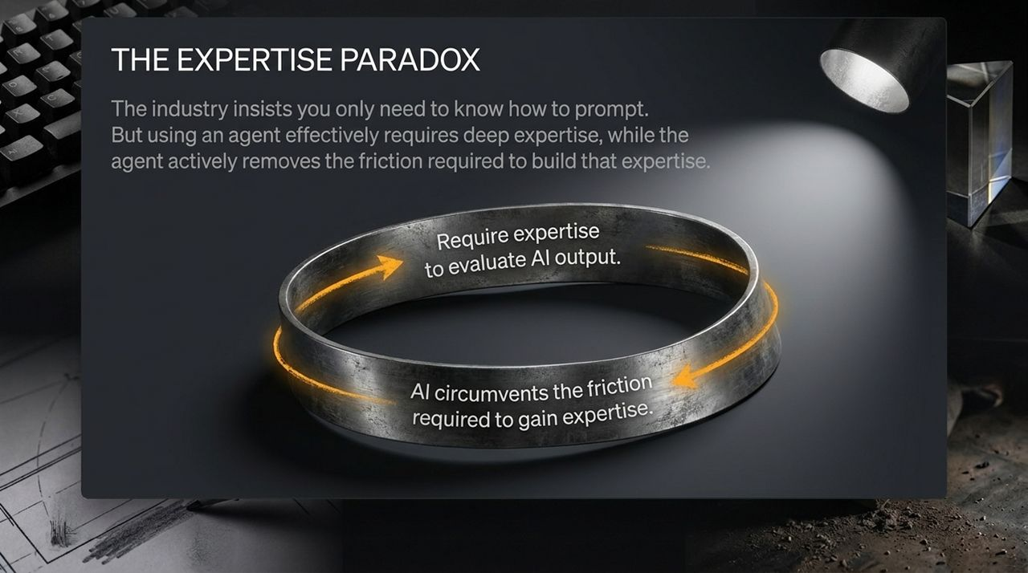
Notes:
Slide 3 outlines what Lars Faye calls The Expertise Paradox—a foundational catch-22 in modern AI-assisted software development.
[Requires Deep Expertise to Evaluate AI Output]
▲
│ (Paradoxical Tension)
▼
[AI Circumvents the Friction Needed to Gain Expertise]
The Catch-22 Breakdown:
Condition A: To effectively use an AI coding agent without getting burned, you must possess deep, foundational domain expertise. You must be able to read the code the agent outputs, audit its security implications, evaluate its performance trade-offs, and catch non-deterministic hallucinations.
Condition B: However, relying on an agentic workflow from day one removes the cognitive friction, struggle, and hands-on practice required to develop that very expertise.
How We Got Here:
In traditional software engineering, a junior developer learns by hitting walls. They struggle with syntax errors, wrestle with pointer arithmetic, waste hours debugging a state mutation, and read documentation line-by-line.
That painful, slow friction builds neural pathways and deep mental models. It develops what engineers call "taste" and intuition.
When a junior developer delegates problem-solving to an AI agent, they bypass that friction entirely. The agent gives them a working block of code instantly. The junior developer feels productive, but they haven't actually learned why the code works or where it will break.
The Industry Crisis:
This creates a dangerous generational pipeline problem:
Where do future senior engineers come from?
If the entry-level tier of development is automated away or replaced by prompt engineering, junior developers will never cross the friction threshold required to become senior architects who can audit AI outputs.
We are creating a world that requires master developers to supervise AI, while simultaneously destroying the pipeline that trains master developers.

Slide 4
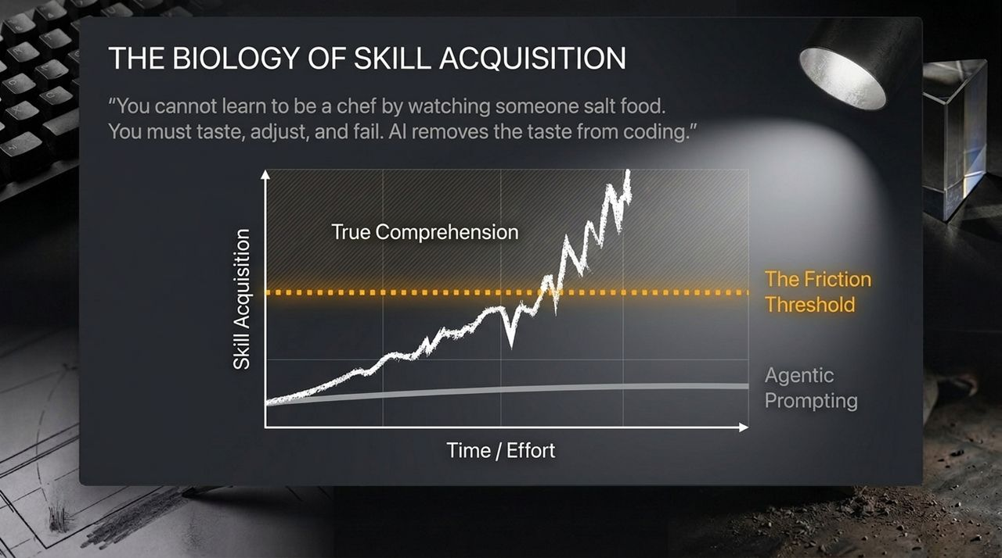
Notes:
To understand why agentic prompting fails as a learning tool, we must look at The Biology of Skill Acquisition on Slide 4.
The Culinary Analogy:
As Lars Faye colorfully points out: "You cannot learn to be a chef by watching someone salt food. You must taste, adjust, and fail. AI removes the taste from coding."
Imagine trying to become an elite chef by ordering dishes from a high-end restaurant kitchen and placing them on tables. You might learn the names of the dishes, and you might know what good food looks like, but you don't know how to adjust the acidity when a sauce breaks, nor do you understand heat management.
Skill Acquisition
▲
│ True Comprehension (Iterative Failure & Debugging)
│ / \ / \ /
│──────────────────────────────────/────\/────\/── [Friction Threshold]
│ /
│ Agentic Prompting ────────────/──────────────── [Skill Ceiling]
└─────────────────────────────────────────────────────────► Time / Effort
Analyzing the Graph:
Agentic Prompting Line (Gray Bottom Curve): When an individual relies on agentic prompts, their short-term output appears high, but their actual skill acquisition hits a low plateau. They stay below the Friction Threshold. They don't build muscle memory or mental models because they never endure the cognitive effort of debugging their own mistakes.
True Comprehension Line (White Oscillating Curve): True mastery is non-linear and messy. It involves trial, error, failure, confusion, and breakthroughs. Each dip in the curve represents a bug or system failure; each peak represents a newly internalized architectural concept.
The Takeaway:
Cognitive friction is not a bug in the learning process; friction is the learning process. When you use AI to eliminate friction, you eliminate learning. You trade long-term cognitive capability for short-term velocity.

Slide 5
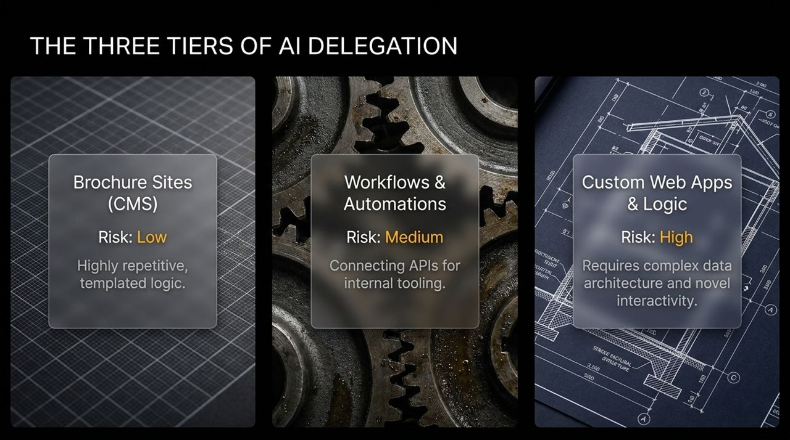
Notes:
Not all software tasks carry the same level of risk when delegated to AI. Slide 5 introduces a practical decision matrix: The Three Tiers of AI Delegation.
Tier 1: Brochure Sites (CMS) ──> Tier 2: Workflows & Automations ──> Tier 3: Custom Web Apps & Logic
[LOW RISK] [MEDIUM RISK] [HIGH RISK]
Tier 1: Brochure Sites & Standard CMS (Low Risk)
Characteristics: Highly repetitive, templated layouts, standard HTML/CSS, basic marketing pages.
Delegation Safety: High. If an AI generates a layout glitch on a static marketing page, the blast radius is minimal. The logic is simple, and security risks are low.
Tier 2: Workflows & Automations (Medium Risk)
Characteristics: Glue code connecting third-party APIs, Zapier/Make scripts, automated data transformation, internal admin tools.
Delegation Safety: Moderate. AI handles boilerplate API integrations well. However, failure risks emerge around edge cases, authentication token handling, rate-limiting, and error recovery.
Tier 3: Custom Web Applications & Core Logic (High Risk)
Characteristics: Novel user interactions, complex multi-tenant data architecture, financial transaction processing, real-time data sync, state management.
Delegation Safety: Dangerous. Custom logic requires precise structural design. AI models lack a holistic understanding of system state and data flow. Delegating Tier 3 logic to an agent without strict line-by-line human auditing leads directly to catastrophic architectural debt.
Guidance for Tech Leaders:
Establish clear boundary lines. Allow AI agents to speed up Tier 1 templates and Tier 2 boilerplate, but strictly guard Tier 3 architecture with human cognitive oversight.

Slide 6
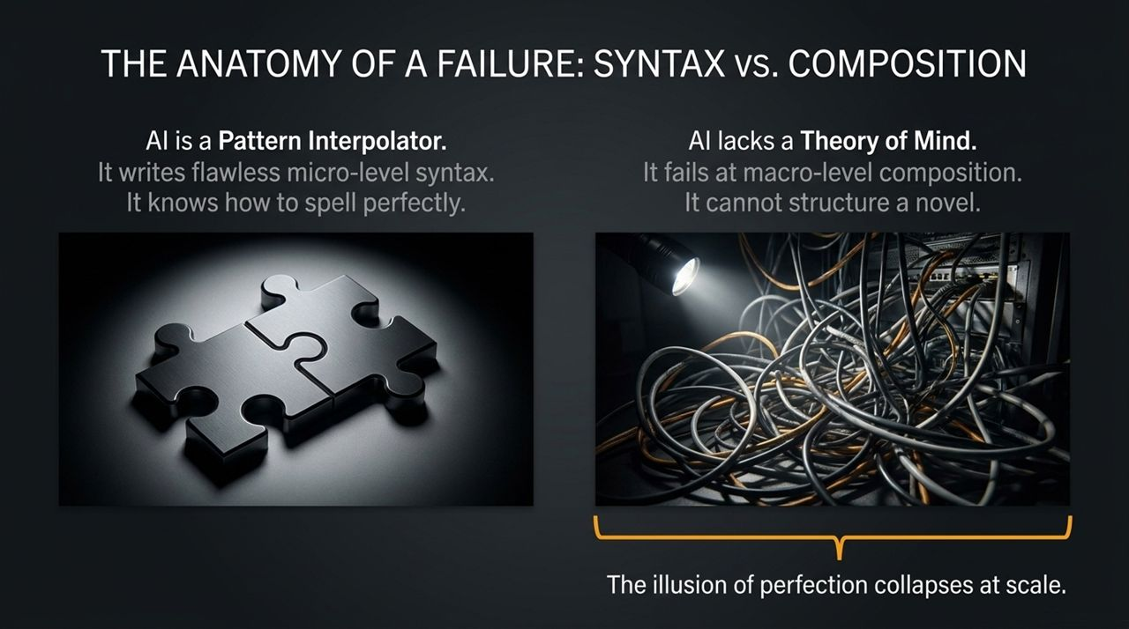
Notes:
Slide 6 exposes the fundamental technical limitation of Large Language Models: The distinction between Micro-Level Syntax and Macro-Level Composition.
[MICRO-LEVEL SYNTAX] ──> Flawless (Spelling, Grammar, Local Functions) ──> AI Excel
VS
[MACRO-LEVEL COMPOSITION] ──> Broken (Architecture, State, Systems Thinking) ──> AI Fails
1. AI as a Pattern Interpolator (Micro-Level Syntax)
LLMs are world-class pattern interpolators. They have ingested billions of lines of public code from GitHub.
Consequently, an LLM knows how to write a perfectly formatted regex pattern, construct a SQL query, or write a local helper function. At the micro-level, the syntax is clean and looks flawless. It is the equivalent of an author who has perfect spelling and grammar.
2. The Missing Theory of Mind (Macro-Level Composition)
However, software engineering is not spelling; it is novel writing.
An LLM has no internal mental model, no "theory of mind," and no awareness of how a change in line 50 of File A impacts memory consumption or state mutation in File Z six months down the road.
It cannot compose a coherent macro-architecture. It stitches together locally optimal snippets that are globally disastrous when combined.
The Illusion of Perfection at Scale:
When a developer asks an agent to generate a small component, it looks brilliant.
But as the codebase grows to 10,000 or 100,000 lines of code, the lack of an overarching architectural vision causes the system to degrade.
Duplicate logic accumulates, state mutations collide, dependencies conflict, and performance collapses. The initial illusion of rapid progress dissolves into an un-debuggable maze of spaghetti code.

Slide 7
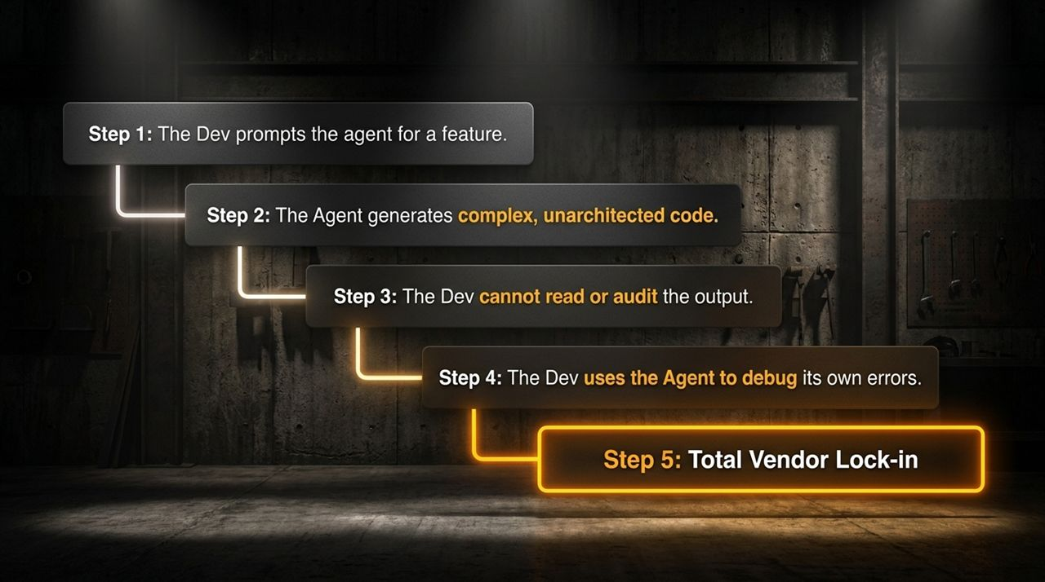
Notes:
Slide 7 maps the exact operational sequence that turns a promising AI project into an unmaintainable nightmare: The Agentic Failure Loop.
Step 1: Prompt Agent for Feature
│
▼
Step 2: Agent Generates Unarchitected Code
│
▼
Step 3: Developer Cannot Read or Audit Output
│
▼
Step 4: Developer Uses Agent to Debug Agent Errors
│
▼
Step 5: Total Vendor Lock-in & Cognitive Collapse
Step-by-Step Breakdown:
Step 1: The Prompt. A developer or founder asks the agent to implement a complex feature.
Step 2: Unarchitected Generation. The agent outputs hundreds of lines of code. Because the agent generates code instantly, it bypasses standard design docs and refactoring steps.
Step 3: Audit Failure. Because the developer didn't write the code and lacks deep familiarity with the codebase, they cannot effectively audit it. They glance at the UI, see that the button works, and merge the Pull Request.
Step 4: Recursive Debugging. A bug inevitably appears. Instead of stepping through the code with a debugger, the developer pastes the error message back into the AI agent and says, "Fix this." The agent patches the bug by adding another layer of unarchitected complexity.
Step 5: Total Vendor Lock-in & Cognitive Traps. The developer no longer understands their own codebase. They are completely dependent on the AI vendor's subscription to maintain or update the application. They are locked into a tool they cannot verify, managing a system they cannot read.

Slide 8
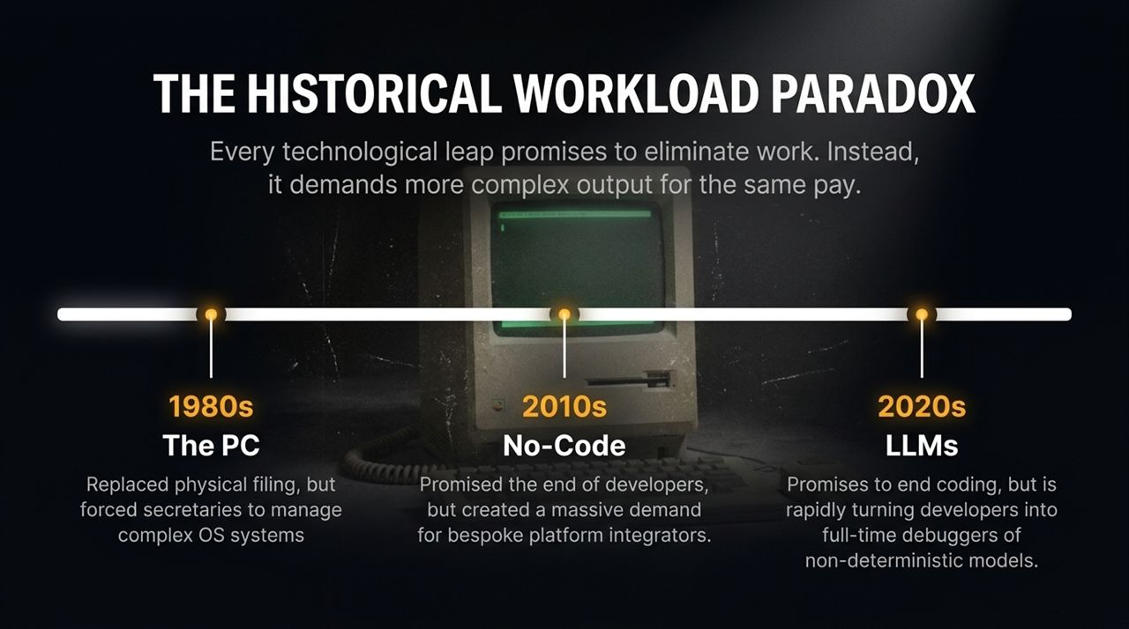
Notes:
Every time a new technology arrives, tech commentators make the same prediction: "This will eliminate human work and make developers obsolete." Slide 8 places our current moment in historical context through The Workload Paradox.
1980s: The PC ──> Promised paperless office ──> Created complex OS/IT management demand.
2010s: No-Code ──> Promised end of devs ──> Created massive demand for platform integrators.
2020s: LLMs ──> Promises end of coding ──> Turning devs into full-time model debuggers.
Historical Evidence:
The Personal Computer (1980s):
The Promise: PCs were supposed to eliminate administrative staff and filing clerks, creating a "paperless office."
The Reality: PCs skyrocketed the volume of documents, spreadsheets, and communications required, forcing administrative workers to master complex operating systems and software tools.
No-Code / Low-Code Platforms (2010s):
The Promise: Drag-and-drop builders were touted as the "death of custom software development."
The Reality: Business workflows became more intricate. Companies needed specialized engineers to manage API integrations, webhooks, and platform limitations.
Large Language Models (2020s):
The Promise: AI will eliminate the need for human programmers.
The Reality: LLMs make generating basic code cheap, which exponentially increases the total volume of software being created. More software means more edge cases, more integration challenges, and more technical debt.
Core Takeaway:
New tools don't eliminate human work; they shift the nature of human work upward. Developers are not being replaced; they are being forced to become full-time evaluators and debuggers of non-deterministic AI systems.

Slide 9
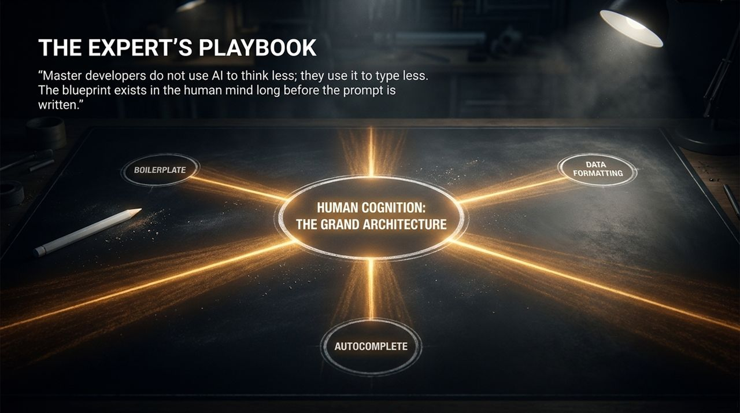
Notes:
How do master developers actually use AI tools without falling into the cognitive trap? Slide 9 outlines The Expert's Playbook.
The Foundational Principle:
"Master developers do not use AI to think less; they use it to type less. The blueprint exists in the human mind long before the prompt is written."
┌──────────────────────────────────────────┐
│ HUMAN COGNITION (THE CORE) │
│ System Architecture & Design Intent │
└────────────────────┬─────────────────────┘
│
┌──────────────────────────┼──────────────────────────┐
▼ ▼ ▼
[Boilerplate Gen] [Autocomplete] [Data Formatting]
(Peripheral AI) (Peripheral AI) (Peripheral AI)
How Experts Leverage AI:
Architectural Authority: The human developer retains 100% control over system design, data modeling, API boundaries, and security architecture. The mental blueprint is constructed before touching an AI tool.
Delegating Mundane Repetition: Experts treat AI as a peripheral typing assistant. They use it for repetitive boilerplate generation, syntax lookup, unit test stubbing, and data reformatting.
Continuous Code Auditing: When an expert uses an AI autocomplete or prompt snippet, they read every line output before accepting it. If the AI introduces unnecessary abstraction, the expert rejects it immediately.
Key Takeaway:
Keep AI on the periphery of your workflow. Use it to reduce mechanical typing friction, but never delegate structural decision-making.

Slide 10
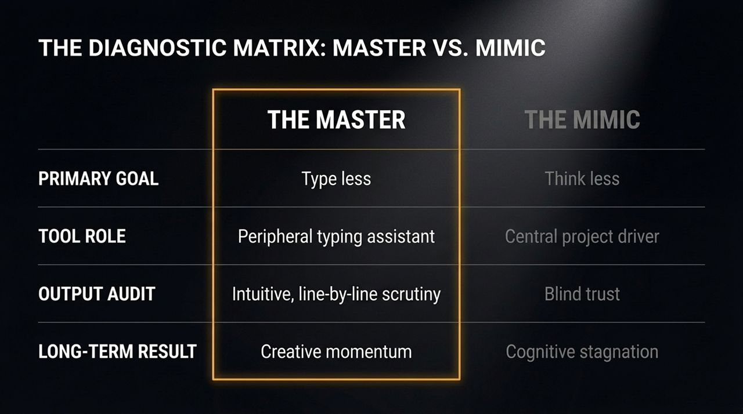
Notes:
Slide 10 provides a clear diagnostic framework to evaluate developer behavior within an organization: The Master vs. The Mimic.
Feature The Master Developer The AI Mimic
Primary GoalType Less (Reduce mechanical toil)
Think Less (Outsource cognition)
Role of AI ToolPeripheral typing & search assistant
Central project driver & decision maker
Output Audit
Rigorous, line-by-line critical analysis
Blind trust & copy-pasting
Response to ErrorsSteps through with debugger; traces root causeRe-prompts agent: "Fix this error."
Long-Term Outcome
Accelerated creative velocity & agency
Cognitive atrophy & total AI dependency
Detailed Analysis:
The Master: Uses AI to eliminate boilerplate speedbumps while keeping their hands firmly on the wheel. When the AI makes a mistake, the Master spots it instantly because they understand the underlying system mechanics.
The Mimic: Operates as a prompt operator. They paste prompts, accept generated code without reading it, and hope it passes integration tests. When something breaks, they are completely helpless because they never understood the system to begin with.
Organizational Impact:
Engineering organizations that hire or train "Mimics" may see short-term feature throughput spikes, but will suffer long-term systemic failures, security breaches, and unmaintainable codebases.

Slide 11
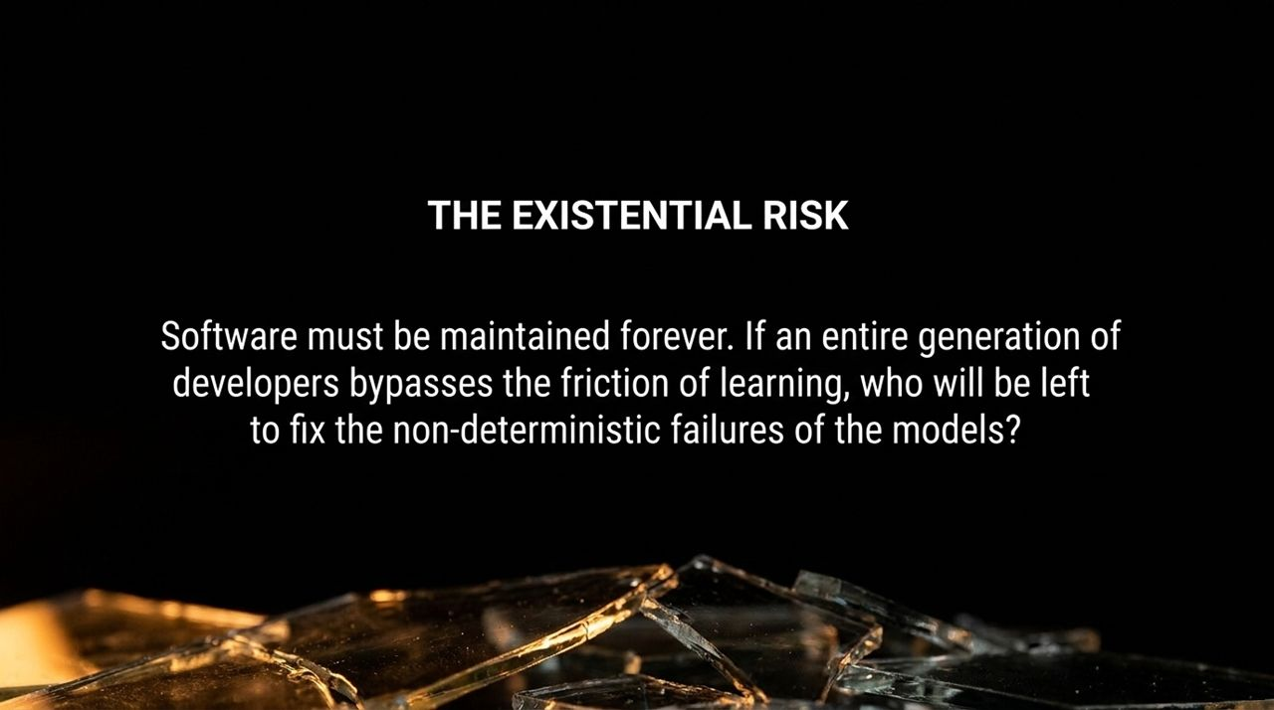
Notes:
Slide 11 addresses the industry-wide, macro risk of over-relying on agentic workflows: The Systemic Maintenance Crisis.
[Software Must Be Maintained Forever]
│
▼
[Bypassing Learning Friction Destroys Mastery Pipeline]
│
▼
[Who Fixes Non-Deterministic Failures When AI Fails?]
1. Software is Permanent Maintenance
Writing code is a small fraction of the software lifecycle; maintaining code over 5, 10, or 20 years is where the real cost lives.
Software operates in changing environments: operating systems update, security vulnerabilities emerge, third-party APIs deprecate, and business requirements evolve.
2. The Cognitive Pipeline Drain
If an entire generation of incoming engineers uses agentic tools to bypass the friction of learning, we are systematically draining the industry's cognitive reserve.
When non-deterministic LLM models inevitably hallucinate, fail, or produce conflicting logic across large infrastructure, who will be left with the domain expertise to fix the systems?
3. The Subscription Dependency Trap
As Lars Faye warns, relinquishing cognitive power to closed-source, venture-backed AI platforms creates dangerous structural dependencies.
Engineering teams risk losing the ability to build software independently, becoming permanent subscribers dependent on AI vendors to maintain basic digital infrastructure.

Slide 12
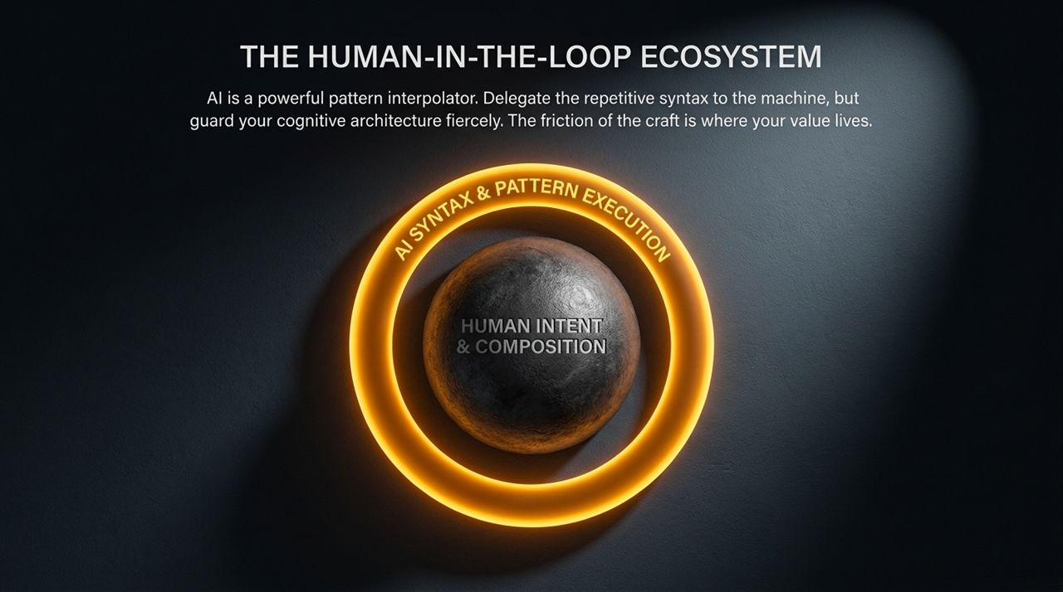
Notes:
Slide 12 presents a balanced, sustainable architecture for modern software teams: The Human-in-the-Loop Ecosystem.
┌──────────────────────────────────────────────────────────┐
│ HUMAN INTENT & COMPOSITION │
│ (System Architecture, Logic, Security, Ethics, Vision) │
└────────────────────────────┬─────────────────────────────┘
│
▼
┌──────────────────────────────────────────────────────────┐
│ AI SYNTAX & PATTERN EXECUTION │
│ (Boilerplate, Autocomplete, Refactoring Snippets) │
└──────────────────────────────────────────────────────────┘
How to Balance the Architecture:
Human Intent & Composition at the Top:
High-level architectural intent, domain modeling, user experience design, security protocols, and system composition must remain strictly within human domain.
AI Syntax & Pattern Execution at the Bottom:
Mechanical implementation, pattern matching, repetitive typing, and local syntax lookup can be delegated to AI engines.
Guarding Your Craft:
Software development is ultimately an exercise in structured thought.
The value of a software engineer does not come from how fast their fingers move across a keyboard; it comes from their ability to reason through complex constraints and build durable solutions.
Do not let tools strip away the cognitive friction that makes software engineering a valuable, creative discipline.

Slide 13
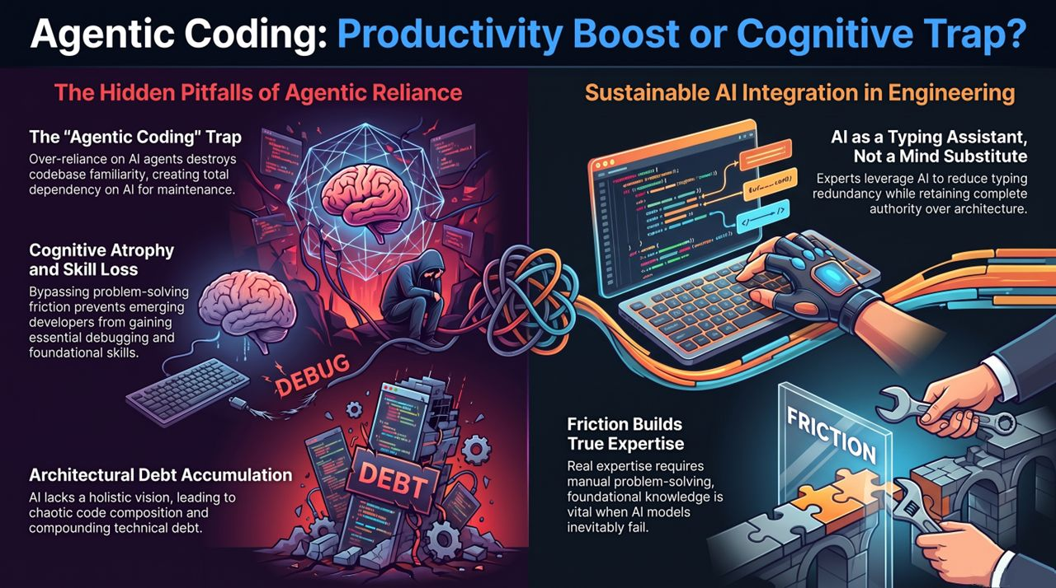
Notes:
Slide 13 summarizes the four main takeaways of the presentation into a clear executive overview.
┌───────────────────────────────────┬───────────────────────────────────┐
│ 1. THE "AGENTIC" TRAP │ 2. COGNITIVE ATROPHY │
│ Total reliance destroys codebase │ Bypassing friction prevents │
│ familiarity & creates dependency. │ gaining essential debug skills. │
├───────────────────────────────────┼───────────────────────────────────┤
│ 3. ARCHITECTURAL DEBT │ 4. FRICTION BUILDS SKILL │
│ LLMs lack holistic vision, │ Manual problem-solving creates │
│ leading to chaotic composition. │ true resilience when models fail. │
└───────────────────────────────────┴───────────────────────────────────┘
Executive Overview Breakdown:
The "Agentic" Trap:
Over-reliance on autonomous agents destroys deep codebase familiarity. If you didn't participate in building the architecture, you cannot effectively maintain or debug it when errors occur.
Cognitive Atrophy & Skill Loss:
Bypassing the friction of problem-solving prevents new engineers from developing essential mental models. Friction is not a barrier to productivity; it is the mechanism of skill acquisition.
Architectural Debt Accumulation:
LLMs excel at local syntax but fail at global composition. Un-audited AI generation creates compounding technical debt and messy codebases.
Friction Builds True Expertise:
Real engineering value lies in reasoning, architecture, and problem decomposition. Master developers use AI as a peripheral typing assistant to type less, while keeping complete authority over system design.
Thank you. I am happy to open the floor to Q&A and discussion.
Only Good Devs Catch AI's Mistakes, and AI Makes You Worse - Lars Faye | Ep. 97
https://www.youtube.com/watch?v=0Kas27lxen4

